Slide 1
Image Processing Techniques to Predict Facial Expressions
Alex G, Sona Maniyan, Princewill Eneh
Dec 2nd, 2014
Notes:
A

Slide 2
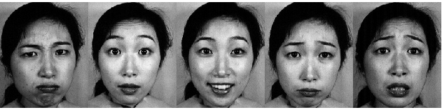
Project Overview
Objective:
For an input image, create a program that predicts the facial expression of the subject in the image.
Dataset: Source of Raw Data: The Japanese Female Facial Expression (JAFFE) Database http://www.kasrl.org/jaffe.html
The database contains 213 images
7 facial expressions (6 basic facial expressions + 1 neutral)
Each image has been rated on 6 emotion adjectives by 60 Japanese subjects.
Notes:
A

Slide 3
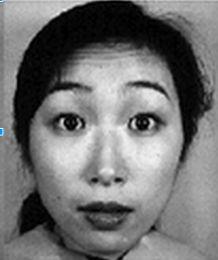
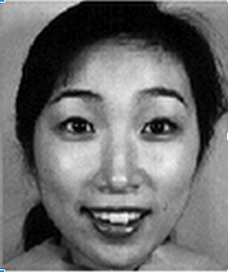
Preliminary Analysis
Facial features that were important in determining facial expressions.
The mouth and the eyes change significantly, while the nose remains fairly static in most cases.
Notes:
P

Slide 4


Tools
Matlab
Packages
Computer Vision System
Cascade Object
R
Packages
nnet
Neural Network
ROCR
ROC Curve
Notes:
P

Slide 5
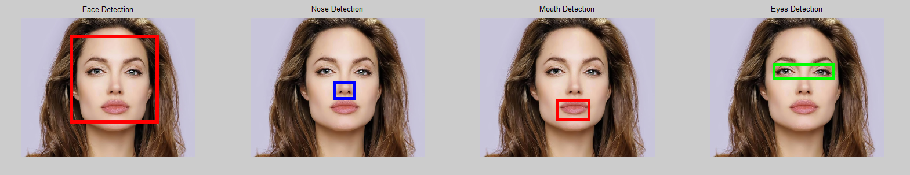
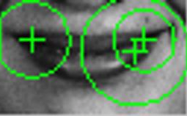
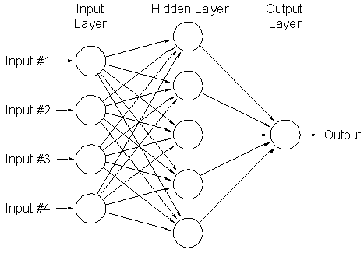
Algorithms
Viola Jones Algorithms
Surf (Speeded up Robust Feature) - Robust local feature detector
Artificial Neural Networks
Notes:
S

Slide 6
Workflow
Dataset
Filter
expressions
Categorize by folders
Isolate the face
Dataset
Pre Processing
Extract relevant facial feature
Acquire feature points
Create dataset
Create training dataset
Isolate Facial features
Test
Evaluate Accuracy
Create classifier
Create and test predictive algorithm
Notes:
S

Slide 7
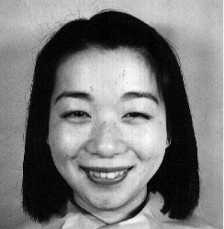
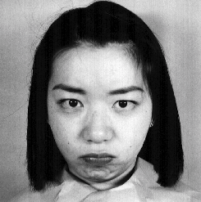
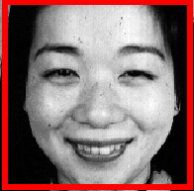
Pre-processing:
Filtering
Select two basic facial expressions happy and angry from seven expression in the original dataset.
Categorizing
The images with two expressions we are looking for are categorized into two folders.
Isolate the Face Region
The face is isolated and all other features are treated as noise.
Notes:
S

Slide 8



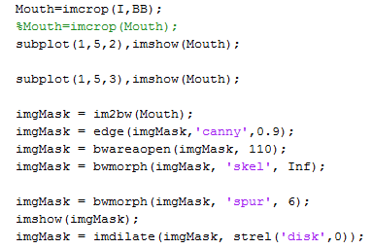
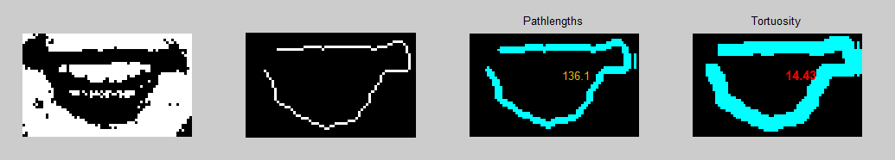
Create Training Dataset
Extract relevant facial feature
Apply Viola Jones Algorithm
Crop out the mouth
Remove Noise
Noise reduction techniques
bwareopen
structural elements
Spur
dilate
Identify Edges
Canny Algorithm
Notes:
a

Slide 9
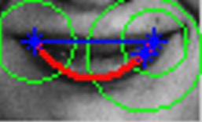
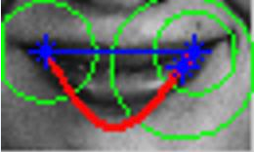
Create Training Dataset contd..
Acquire Feature Points
Coefficients for line of best fit: p_n(x)=c_0+c_1*x^1+c_2*x^2+c_3*x^3+c_4*x^4
Tortuosity
Happy
Angry
Create dataset
Notes:
A P

Slide 10
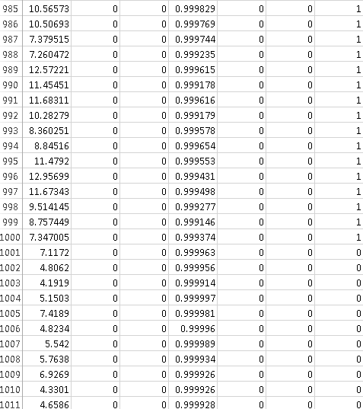
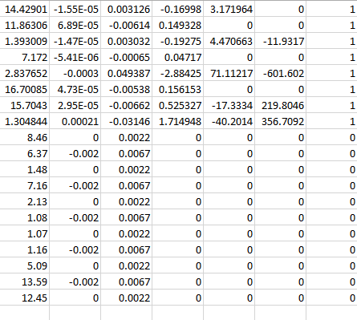
Create Training Dataset contd...
Training Data in Excel Spreadsheet Test Data
Neural Network
Model
Notes:
P

Slide 11
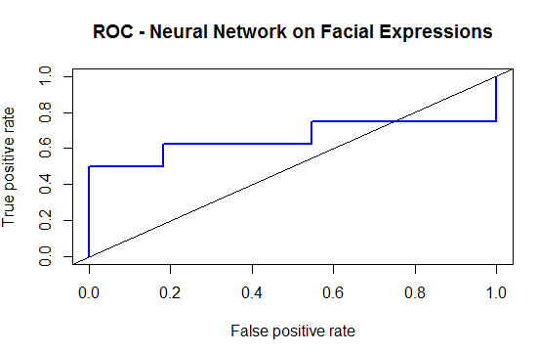
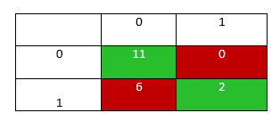
Test Predictive Model
Input Test Data contained attribute values for 19 images - 8 Happy and 11 Angry
Confusion Matrix
1 - Happy
0 - Angry
Area under the curve 0.6590909.
Notes:
S

Slide 12
Challenges
Issues
Coming up with a uniform Dataset
Uncategorized image dataset
Variable thresholds
Noise
Coming up with a MAT file which will best describe our training input metrics (heuristics).
Our knowledge of Matlab was not robust (syntax)
Solutions
Jaffe Database with images
Manually cluster the images
Try-catch statements for debugging purposes
Use techniques from class lectures to remove noise
Using vertical concatenation
Using R’s neural network package
GOOGLE.COM
Notes:
A P

Slide 13
Lesson Learned
Noise removal is an important aspect of image processing
Start with smaller number of images and work your way up
Each process during image processing is important. A poor input can result in poor results in later stages.
Facial features are hard to extract.
Creative solutions to tackle ambiguity
Be open to using multiple tools
Notes:
S

Slide 14
Applications
Medical: Monitor a patient’s face and report expressions to physicians.
Entertainment/Amusement parks: Analyze customer experience before and after event
Shopping/Testing products: Before and after experience
Security: Monitor the expressions of suspects or persons of interest.
Notes:
S

Slide 15
Future Research
Different Facial Features
Different genders
Different Races
Facial expression extraction from video
Additional predictive capabilities (decision trees etc.)
Other Metrics we can employ
Convex Hull
Histograms
Torsion/geodesic paths
Notes:
A

Slide 16
Conclusion
Pulled in data
Reduced noise in Mouth Region
Got Tortuosity and coefficient of degree 4 in the Lip Region
Trained our neural network with a mock dataset.
Learnt what is good and bad data
Notes:
A

Slide 17
References
http://alwaysinfo.co.uk/images/i/face/5
http://www.kasrl.org/jaffe.html
http://scg.sdsu.edu/ann_r/
http://arxiv.org/ftp/arxiv/papers/1204/1204.2073.pdf

